Slide 1
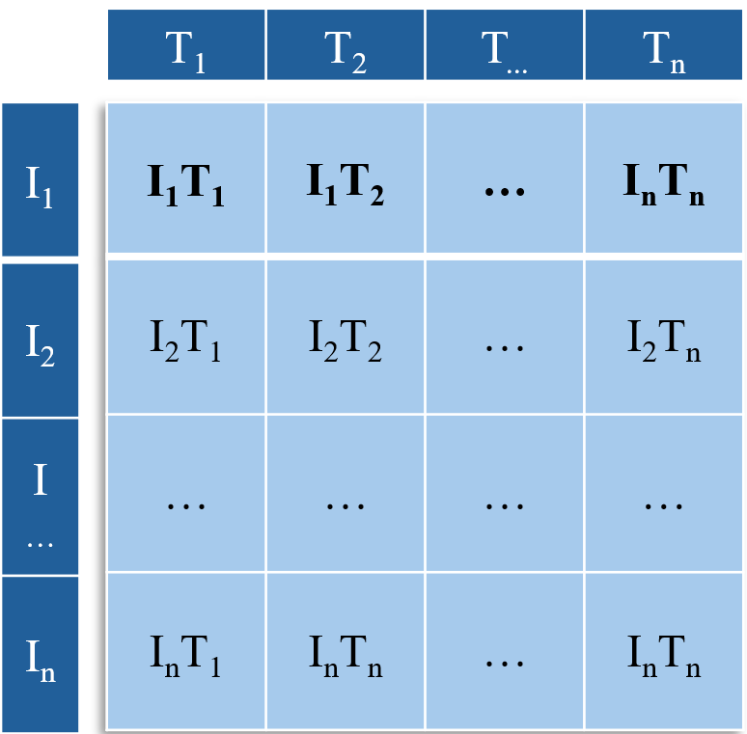
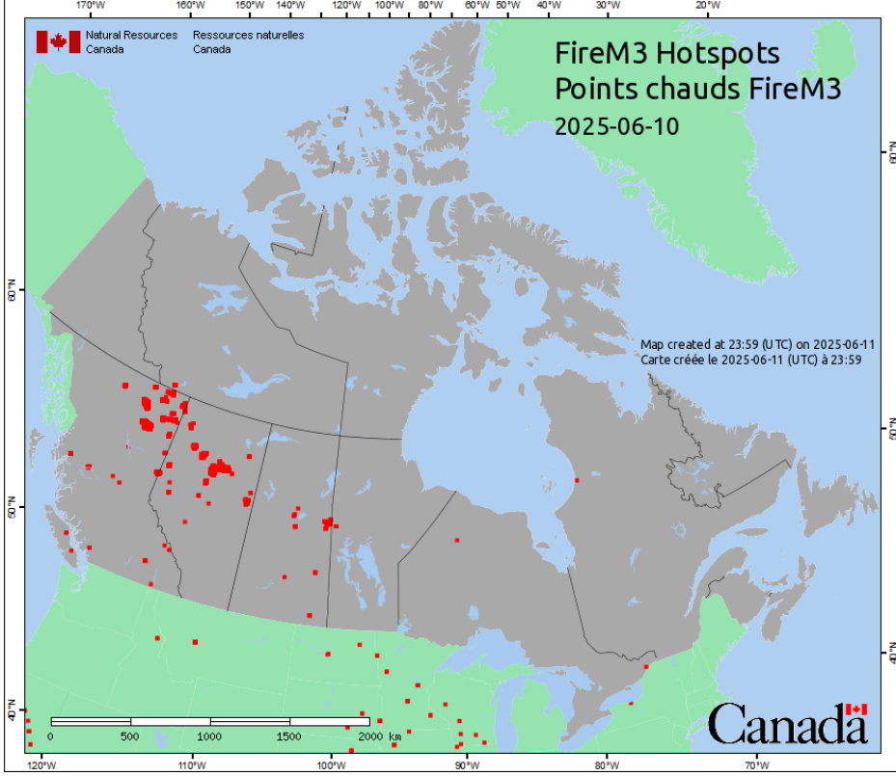
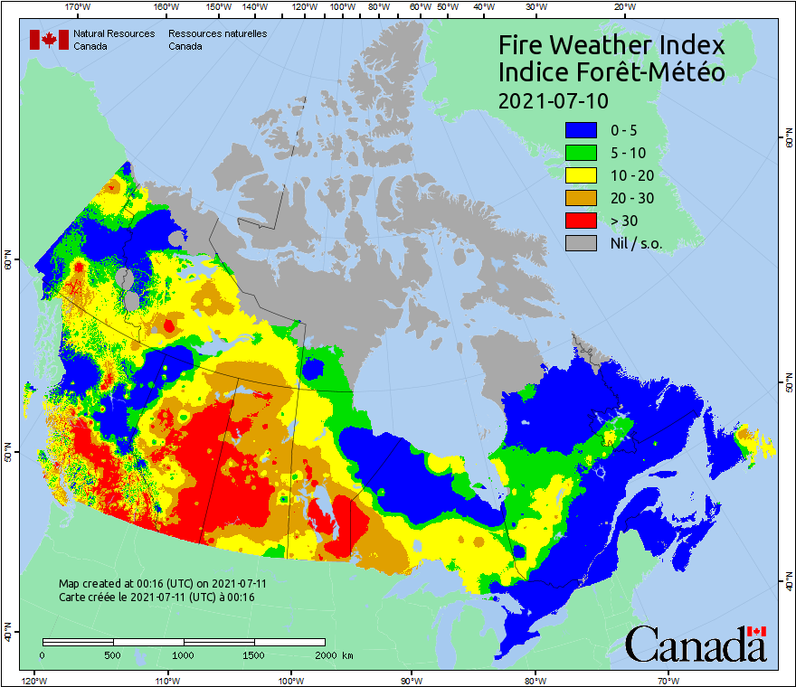
Text Label
Text Encoder
(LSTM Pathway)
LSTM Features
Multi-modal Represen-tation
Fully Connected Layer(s)
Output
Risk Predication
Image Encoder
(ViT Pathway)
M3
FWI
ViT Features

Slide 2
T₁ | T₂ | T... | T_{n}
I₁
I₂
I…
I_{n}
I₁T₁ | I₁T₂ | … | I_{n}T_{n}
I₂T₁ | I₂T₂ | … | I₂T_{n}
… | … | … | …
I_{n}T₁ | I_{n}T_{n} | … | I_{n}T_{n}

Slide 3
Text Label
Text Encoder
Image Encoder
M3
FWI

